Slide 1

ngular
Training – Day 01
Laxman Dasari

Slide 2
Learning Topics
Environment Setup
Overview of tools
Typescript Overview
Typescript Fundamentals
Demo
Typescript and Visual Studio
Sample application

Slide 3
Environment Setup
Required tools and software for this training
NPM (Node Package Manager)
GIT
Visual Studio Code

Slide 4
NPM (Node Package Manager)
What is NPM and why to use it?
npm is a package manager for JavaScript libraries
One stop solution to most of the available client side frameworks
Availability of thousands of ready to use JavaScript libraries
Manages the project dependencies very well compared to manual management
Similar to NuGet in .net world
Ships as bundled with NodeJS
Example of the frameworks which are hosted in npm are Angular, TypeScript, React, Jquery, Bootstrap, Gulp, Grunt etc….
Package Manager URL – https://www.npmjs.com/

Slide 5
Git
GitHub
Distributed Source Control Manager
Source code of all open source client frameworks are hosted in GitHub
We will be pulling some of the angular code from GitHub to start with Angular code
All materials used in this training will be available at following GitHub repository
https://github.com/laxmandasari/Angular-Training

Slide 6
Visual Studio Code
VS Code
Visual Studio code is lightweight and powerful source code editor
Available for Windows, mac and Linux
Built-in support for JavaScript, TypeScript and Node.js
Rich extensions available for various other languages
In-Built support for Git Integration

Slide 7
TypeScript

Slide 8
JavaScript
JavaScript
Universal client side web language
One language supported by every browser
Does not need any special installation
Dynamic type support
Server side support with Node.Js
Support patterns to write clean code

Slide 9

What is the
Problem?

Slide 10
The Problem
Doesn’t support OOPS
Challenge to server side developers due to lack of OO support
Powerful dynamic type support becomes road block in larger applications
No good IntelliSense support
No compile time errors
Maintainability issues in larger applications due to late detection of errors
Developers doesn’t follow patterns

Slide 11

JavaScript
Picture Courtesy: https://www.pinterest.com/

Slide 12

Still JavaScript is irreplaceable
And
Is King of Client Side Scripting
Picture Courtesy: LiveLuvCreate.com

Slide 13
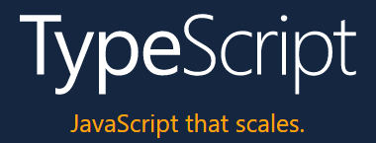
Solution?

Slide 14
What is TypeScript?
“TypeScript is a typed superset of JavaScript that compiles to plain JavaScript”

Slide 15
TypeScript
New language built on top of JavaScript
Not a replacement of JavaScript
Superset of JavaScript
Sugar coating to JavaScript to introduce OO constructs
Transpiles in to clean, simple JavaScript which runs on any browser
Type safety and compile time type checking
Better modularity with introduction of OOPS concepts
Supports ECMAScript 3 and newer versions of JavaScript

Slide 16

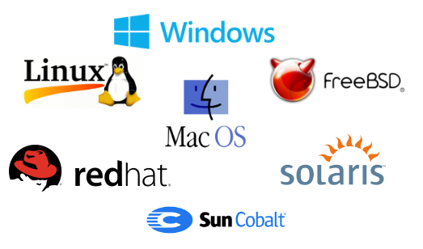
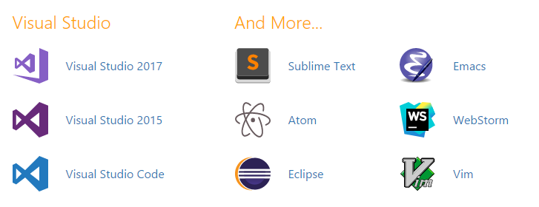

Any Browser
Any OS
Better Support of Tools
Open Source

Slide 17
TypeScript Key Features
Supports Standard JavaScript Code
Provides Static Typing
Encapsulation and Inheritance through classes
Interfaces
Lambda Expressions
Support for Constructors, Properties, Functions etc.

Slide 18

TypeScript
var __extends = (this && this.__extends) || (function () {
var extendStatics = Object.setPrototypeOf ||
({ __proto__: [] } instanceof Array && function (d, b) { d.__proto__ = b; }) ||
function (d, b) { for (var p in b) if (b.hasOwnProperty(p)) d[p] = b[p]; };
return function (d, b) {
extendStatics(d, b);
function __() { this.constructor = d; }
d.prototype = b === null ? Object.create(b) : (__.prototype = b.prototype, new __());
};
})();
var Animal = (function () {
function Animal(name) {
this.name = name;
}
Animal.prototype.move = function (distanceInMeters) {
if (distanceInMeters === void 0) { distanceInMeters = 0; }
console.log(this.name + " moved " + distanceInMeters + "m.");
};
return Animal;
}());
var Snake = (function (_super) {
__extends(Snake, _super);
function Snake(name) {
return _super.call(this, name) || this;
}
Snake.prototype.move = function (distanceInMeters) {
if (distanceInMeters === void 0) { distanceInMeters = 5; }
console.log("Slithering...");
_super.prototype.move.call(this, distanceInMeters);
};
return Snake;
}(Animal));
class Animal {
constructor(public name: string) { }
move(distanceInMeters: number = 0) {
console.log(`${this.name} moved ${distanceInMeters}m.`);
}
}
class Snake extends Animal {
constructor(name: string) { super(name); }
move(distanceInMeters = 5) {
console.log("Slithering...");
super.move(distanceInMeters);
}
}
TSC

Slide 19

TypeScript
Picture Courtesy: https://www.pinterest.com/

Slide 20
DEMO

Slide 21
Play ground
https://www.typescriptlang.org/play/index.html

Slide 22


Visual Studio &
TypeScript

Slide 23
TypeScript Alternatives?
Follow JavaScript patterns to write clean code
CoffeScript
DART

Slide 24
Reference Materials
https://www.typescriptlang.org/docs/tutorial.html
https://github.com/Microsoft/TypeScript
https://app.pluralsight.com/library/courses/typescript/table-of-contents
https://app.pluralsight.com/library/courses/typescript-in-depth/table-of-contents
http://www.codeproject.com/Articles/802722/TypeScript-The-Basics

Slide 25
THANK YOU
Happy Learning!
Laxman

